Slide 1

Facebook V: Check-in Predictions
Team 7: Seth Lanza, Kyle Kauffman,
Emma Minnick, Sophia Liu

Slide 2

Introduction to Data & Problem
Goal: Predict which place a person would be likely to check-in to (classification)
Artificial world consisting of 100,000 places within 10km x 10km square
Synthetic data resembles noisy location signals coming from mobile phones
Business objective: use check-in locations to better tailor ads to consumers
The North America indoor location-based services market is projected to reach $14.48 billion by 2026 with a 30.6% annual growth rate driven by technology advancements and increased demand for digital platforms during the COVID-19 pandemic.

Slide 3
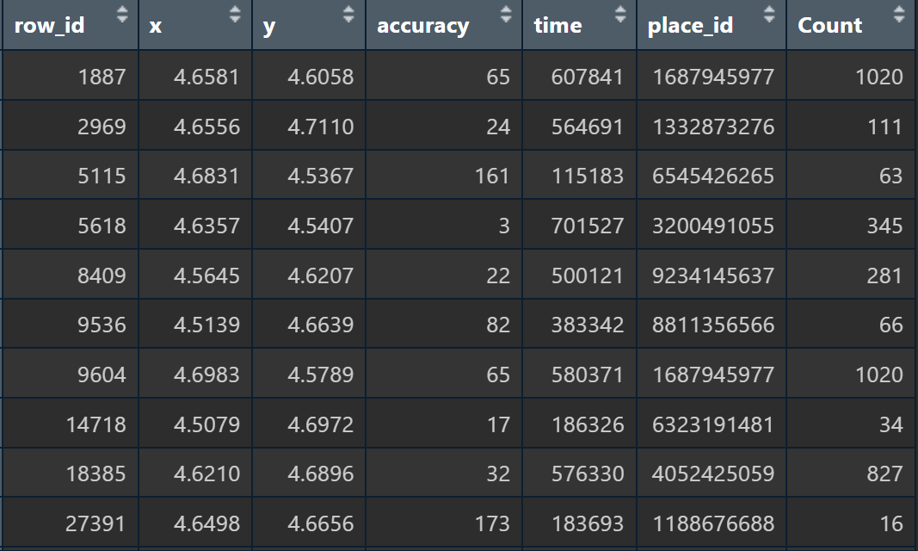
Dataset
train.csv, test.csv
row_id: id of the check-in event
x y: coordinates
accuracy: location accuracy
time: timestamp
place_id: id of the business

Slide 4
Critiques of Other Approaches
Common issues:
Didn’t split test and train for the train dataset
Kept the row_id column in the model
Didn’t evaluate model on any metrics to see how the model did compared to other approaches
Didn’t check different values of K for KNN tuning
Some entries only included data exploration
Some entries used inappropriate models like linear regression with poor accuracy

Slide 5

Our Code

Slide 6
Privacy concerns
Facebook may be collecting and storing users' location data without their explicit consent. This data can be used to build detailed profiles of users, which can be used for targeted advertising or sold to third-party advertisers.
This feature may make it easier for Facebook or other entities to track a user's movements and habits, which could be used for nefarious purposes such as stalking or identity theft.
Notes:
Facebook may be collecting and storing users' location data without their explicit consent. This data can be used to build detailed profiles of users, which can be used for targeted advertising or sold to third-party advertisers.

Slide 7
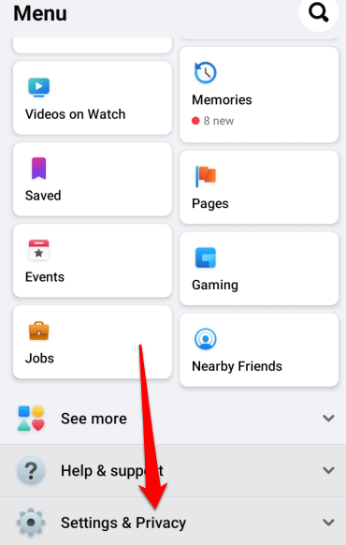
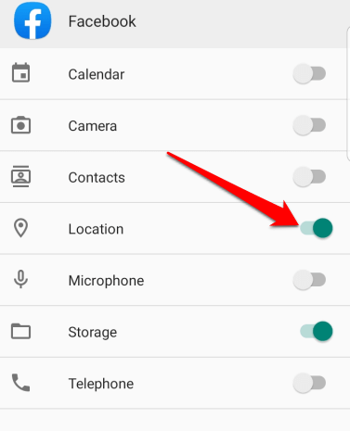
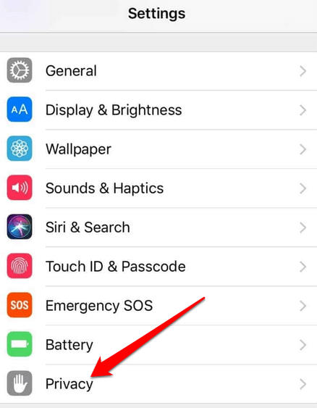
Privacy concerns

Slide 8
Citations
Elliott, S., Adhikari, A., & Liang, P. (2021). How to Avoid Machine Learning Pitfalls: A Guide for Academic Researchers. arXiv preprint arXiv:2108.02497.
Prathamesh3103. (2021). K-Nearest Neighbor. Retrieved April 18, 2023, from Kaggle website: https://www.kaggle.com/code/prathamesh3103/k-nearest-neighbor
libra202ma. (2021). House Price Prediction. Retrieved April 18, 2023, from Kaggle website: https://www.kaggle.com/code/libra202ma/notebooke5c6af7da0

